Slide 1
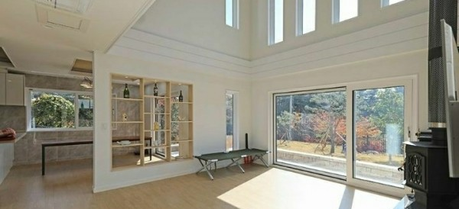

2021-1 MLDL Final Report
Estimate the timing and intensity of
the daylight coming in the room
2021.06.24
We Go UP
Yeon Bae, Taeye Kwack,
Juhyeon Kim, Seongyong Park
Seoul National University
Graduate School of Data Science

Slide 2
Contents
Introduction
1
Motivation
Related Works (our distinguishable)
Lessons we take
Methodology
2
Data Collection
Preprocessing
Technical Approach
Technical Challenges
Results
3
Results
Novelty / Merit
Future Plan
4
Limitation
Future Work

Slide 3
Introduction

Slide 4
The First question when finding a room
Is this room well lighted?
Is this room facing south?
Why do we ask whether it is facing south and well lighted?

Slide 5


Motivation
Introduction
PROBLEM
SOLUTION
The timing and intensity of light coming in is important factor in residential and commercial space.
Since the amount of sunlight is affected by the characteristics of window, the location, and timing, it is difficult to intuitively apprehend at a glance.
To find out the good condition for the well-lighted home
Based on the information of the direction and size of the window, altitude of the building, surrounding environment, and time.
Estimate how much light comes in at a certain time of day using ML method without measuring the daylight.
EXPECTED EFFECT
?
Determine whether the space is suitable for the preference for the light and purpose of use.
It would be also useful when purchasing a house, growing plants, or controlling room temperature in summer!
Seoul National University
Graduate School of Data Science

Slide 6
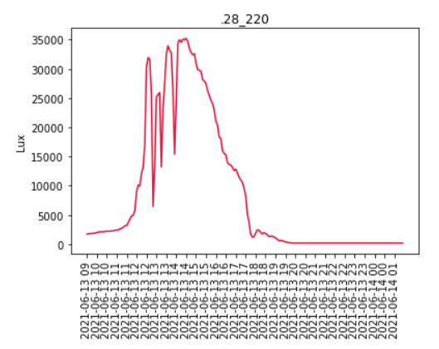
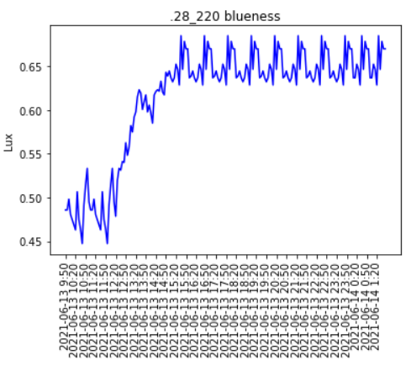
Motivation
Introduction
FIRST IMAGINATION OF OUR MODEL
INPUT
OUTPUT
LOCATION
TIME
DIRECTION
SIZE OF WINDOW
CLOUDINESS
INTENSITY OF INCOMING LIGHT AT TARGET SITE
Longitude: 126.9828873413339
Latitude: 37.52475464417339
Direction: 123° (south east)
Window to Wall ratio: 100%
Cloudiness: “video processing”
Seoul National University
Graduate School of Data Science

Slide 7
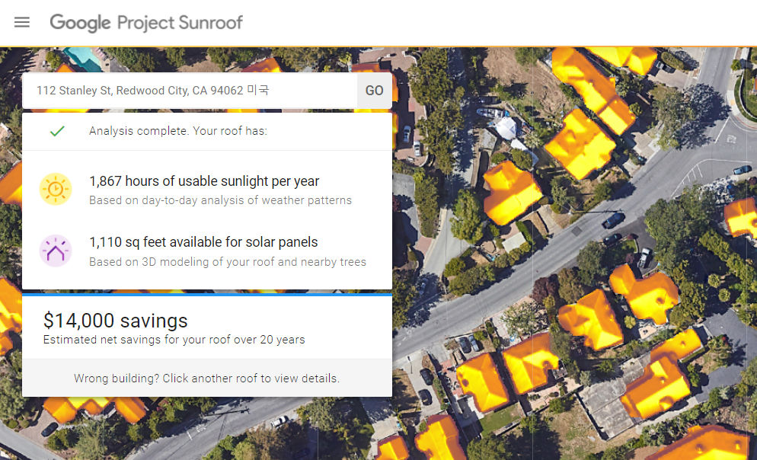
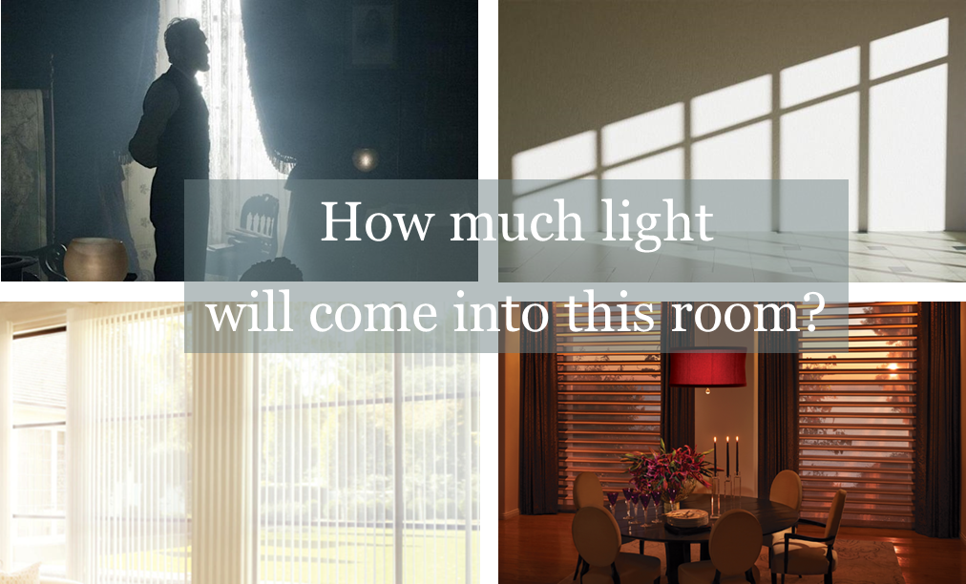
Related Work
Introduction
Google Project Sunroof
Our Work
Imagery and 3D modeling and shade calculations from Google
➔ calculate available area on the roof for solar panels
Weather data from the National Renewable Energy Laboratory (NREL)
➔ calculate usable sunlight per year
Solar pricing data, Solar incentives data, Solar Renewable Energy Credit data
➔ calculate how much they can save the money compared to current electricity rates
Imagery and detector-based lighting estimations from MLDL Class!
➔ Calculate expected luminance from the sunlight focusing on each room and illumination
Weather data from our video detection system using old mobile devices
➔ Detect the clouds in the sky determining the amount of the clouds, rain-clouds
Detailed condition of the rooms like directions and altitudes of observing windows, and distance between the observer and the windows
➔ Catch up ‘how the human does sense the sunlight’ in the room
Seoul National University
Graduate School of Data Science

Slide 8
Lessons we take
Introduction
The lesson we learned from data collection procedure
Issues on automation
Issues on data shortage
After the proposal presentation, the most important issues was ‘how to automate sensing the sunlight’
Considered the single-board microcontrollers like Arduino, Coral board but the sensor part is not adaptable for the range of our interests
Alternatively, considered the mobile phone with luminance sensors in camera however, the similar issues
After the long discussion with our members, we determined to use the dedicated equipment for the luminance sensor with automated recording function
To reduce the human input, the automation was recommended for the data collection, however, during the experiments, we had faced the malfunctions and missing data
We could learn from this experience that configuring reliable data collection system might be equally important part when building a data-prediction model
Finally, we have done with 10 days data however, still we have short-term data to firmly estimate the indoor-lightings for the whole periods of time.
In the initial process, we have missing data issues and bad weather condition. Also, confirming the data collection methodologies also the hard work for the processing this project
Small number of days and observatory locations might lead to overfitting problems even though we had built the appropriate models to predict
Still the most important lesson from the short-time to go might be
“Just Do It.”
“Never put off till tomorrow what you can do today”
Seoul National University
Graduate School of Data Science

Slide 9
Methodology

Slide 10
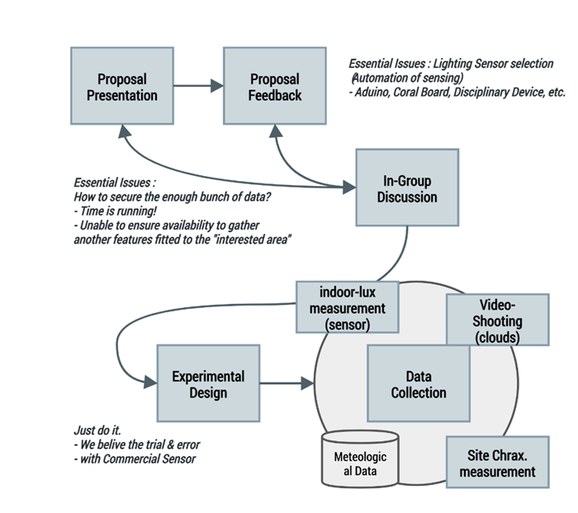
Architecture Design
Methodology

Slide 11
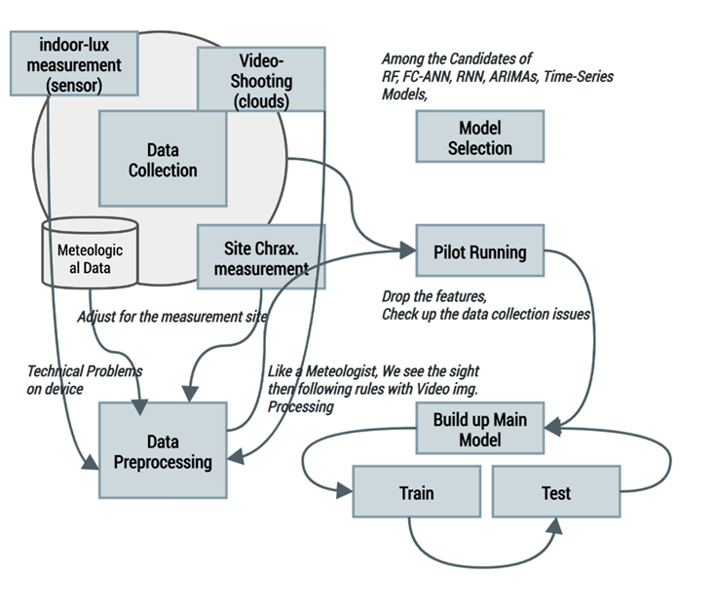
Architecture Design
Methodology

Slide 12










Data Collection
Methodology
Which feature can affect to the illumination in the room?
Timing
Precipitation & Humidity
Radiation Intensity
Solar Zenith Angle
Elevation
Direction of windows
Size of windows
Distance from the windows
Shade from surrounding buildings
Seoul National University
Graduate School of Data Science

Slide 13
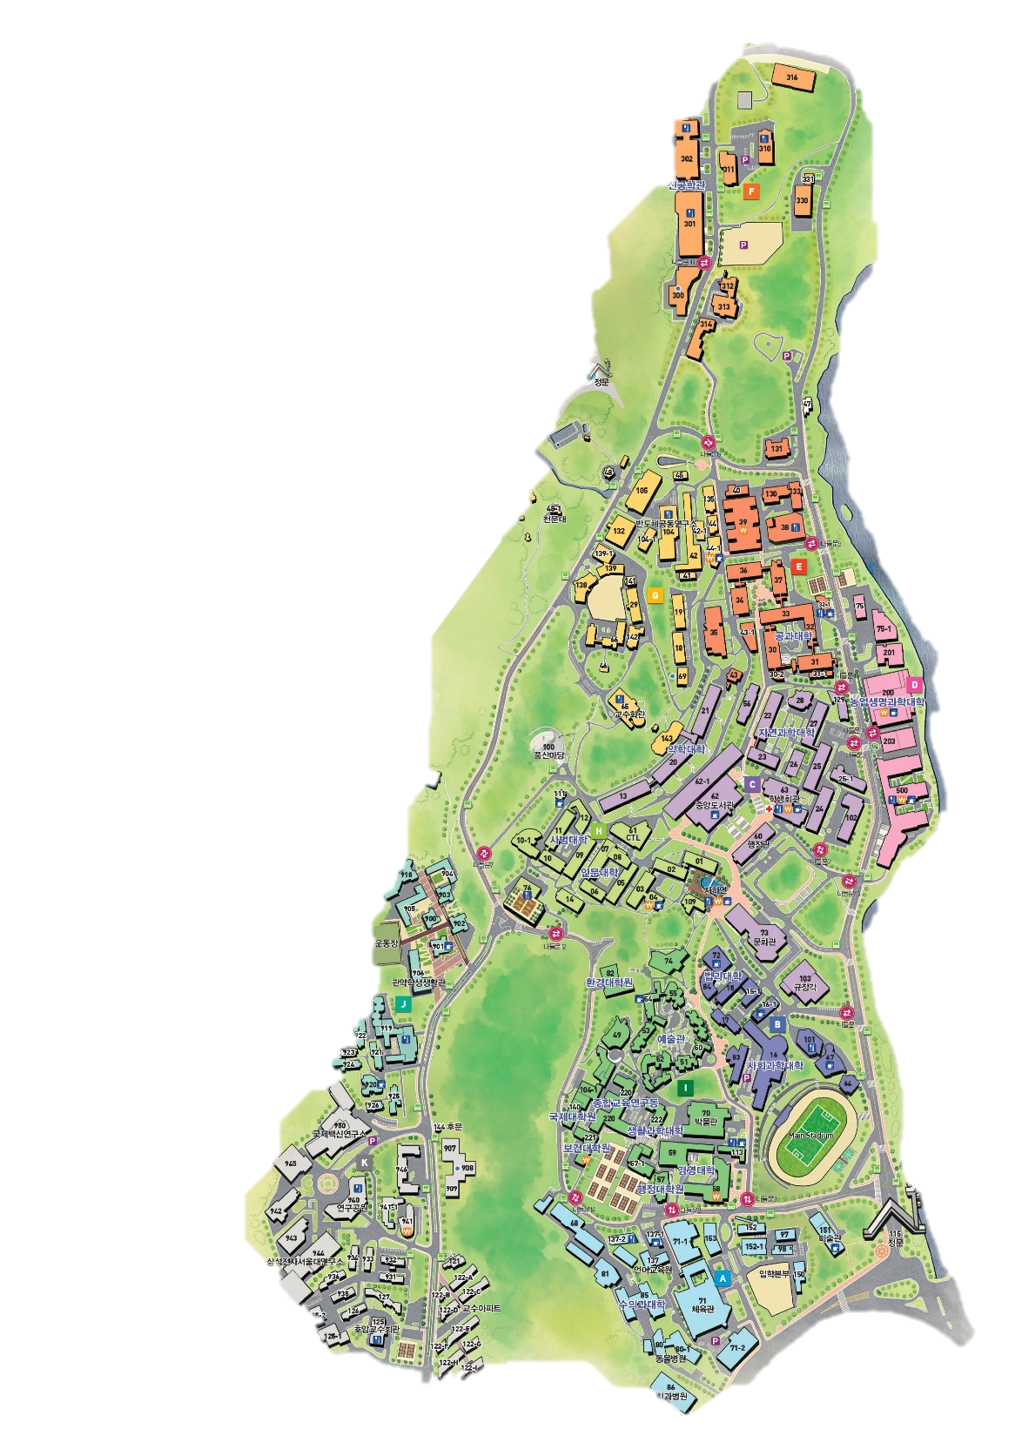
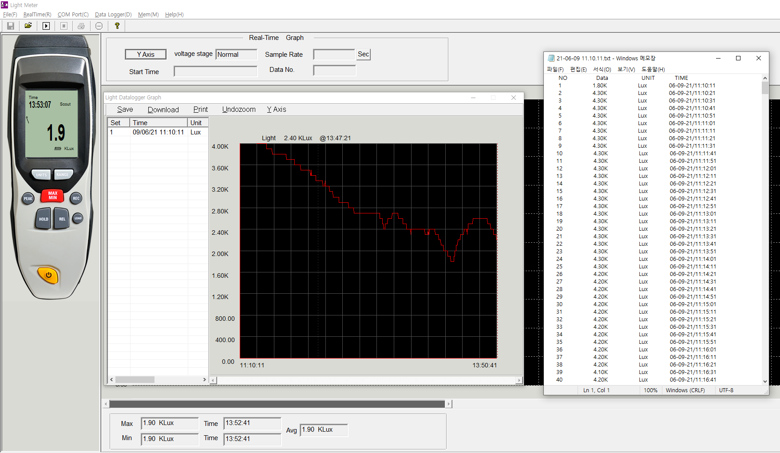
Data Collection
Methodology
1. Intensity of Illuminance
Various places in SNU (BLD 220, BLD 942, BLD 82).
DT – 856 : the illuminometer (Range : 0~ 400,000 Lux / Accuracy : ±5%)
Measured Illuminance every 10 seconds
BLD 82
BLD 220
BLD 942
Seoul National University
Graduate School of Data Science

Slide 14
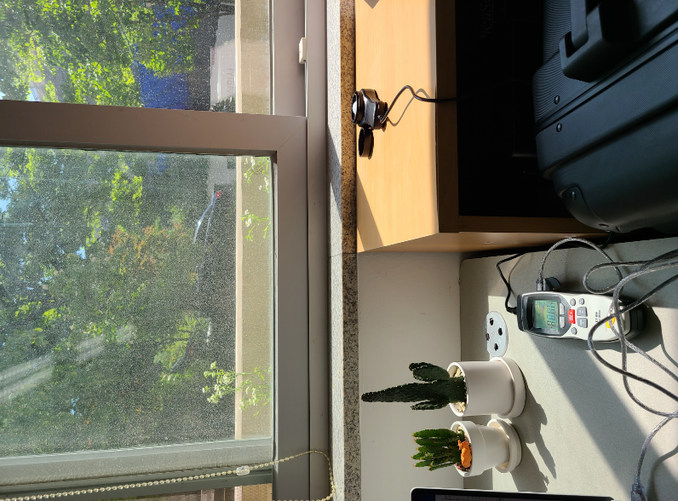
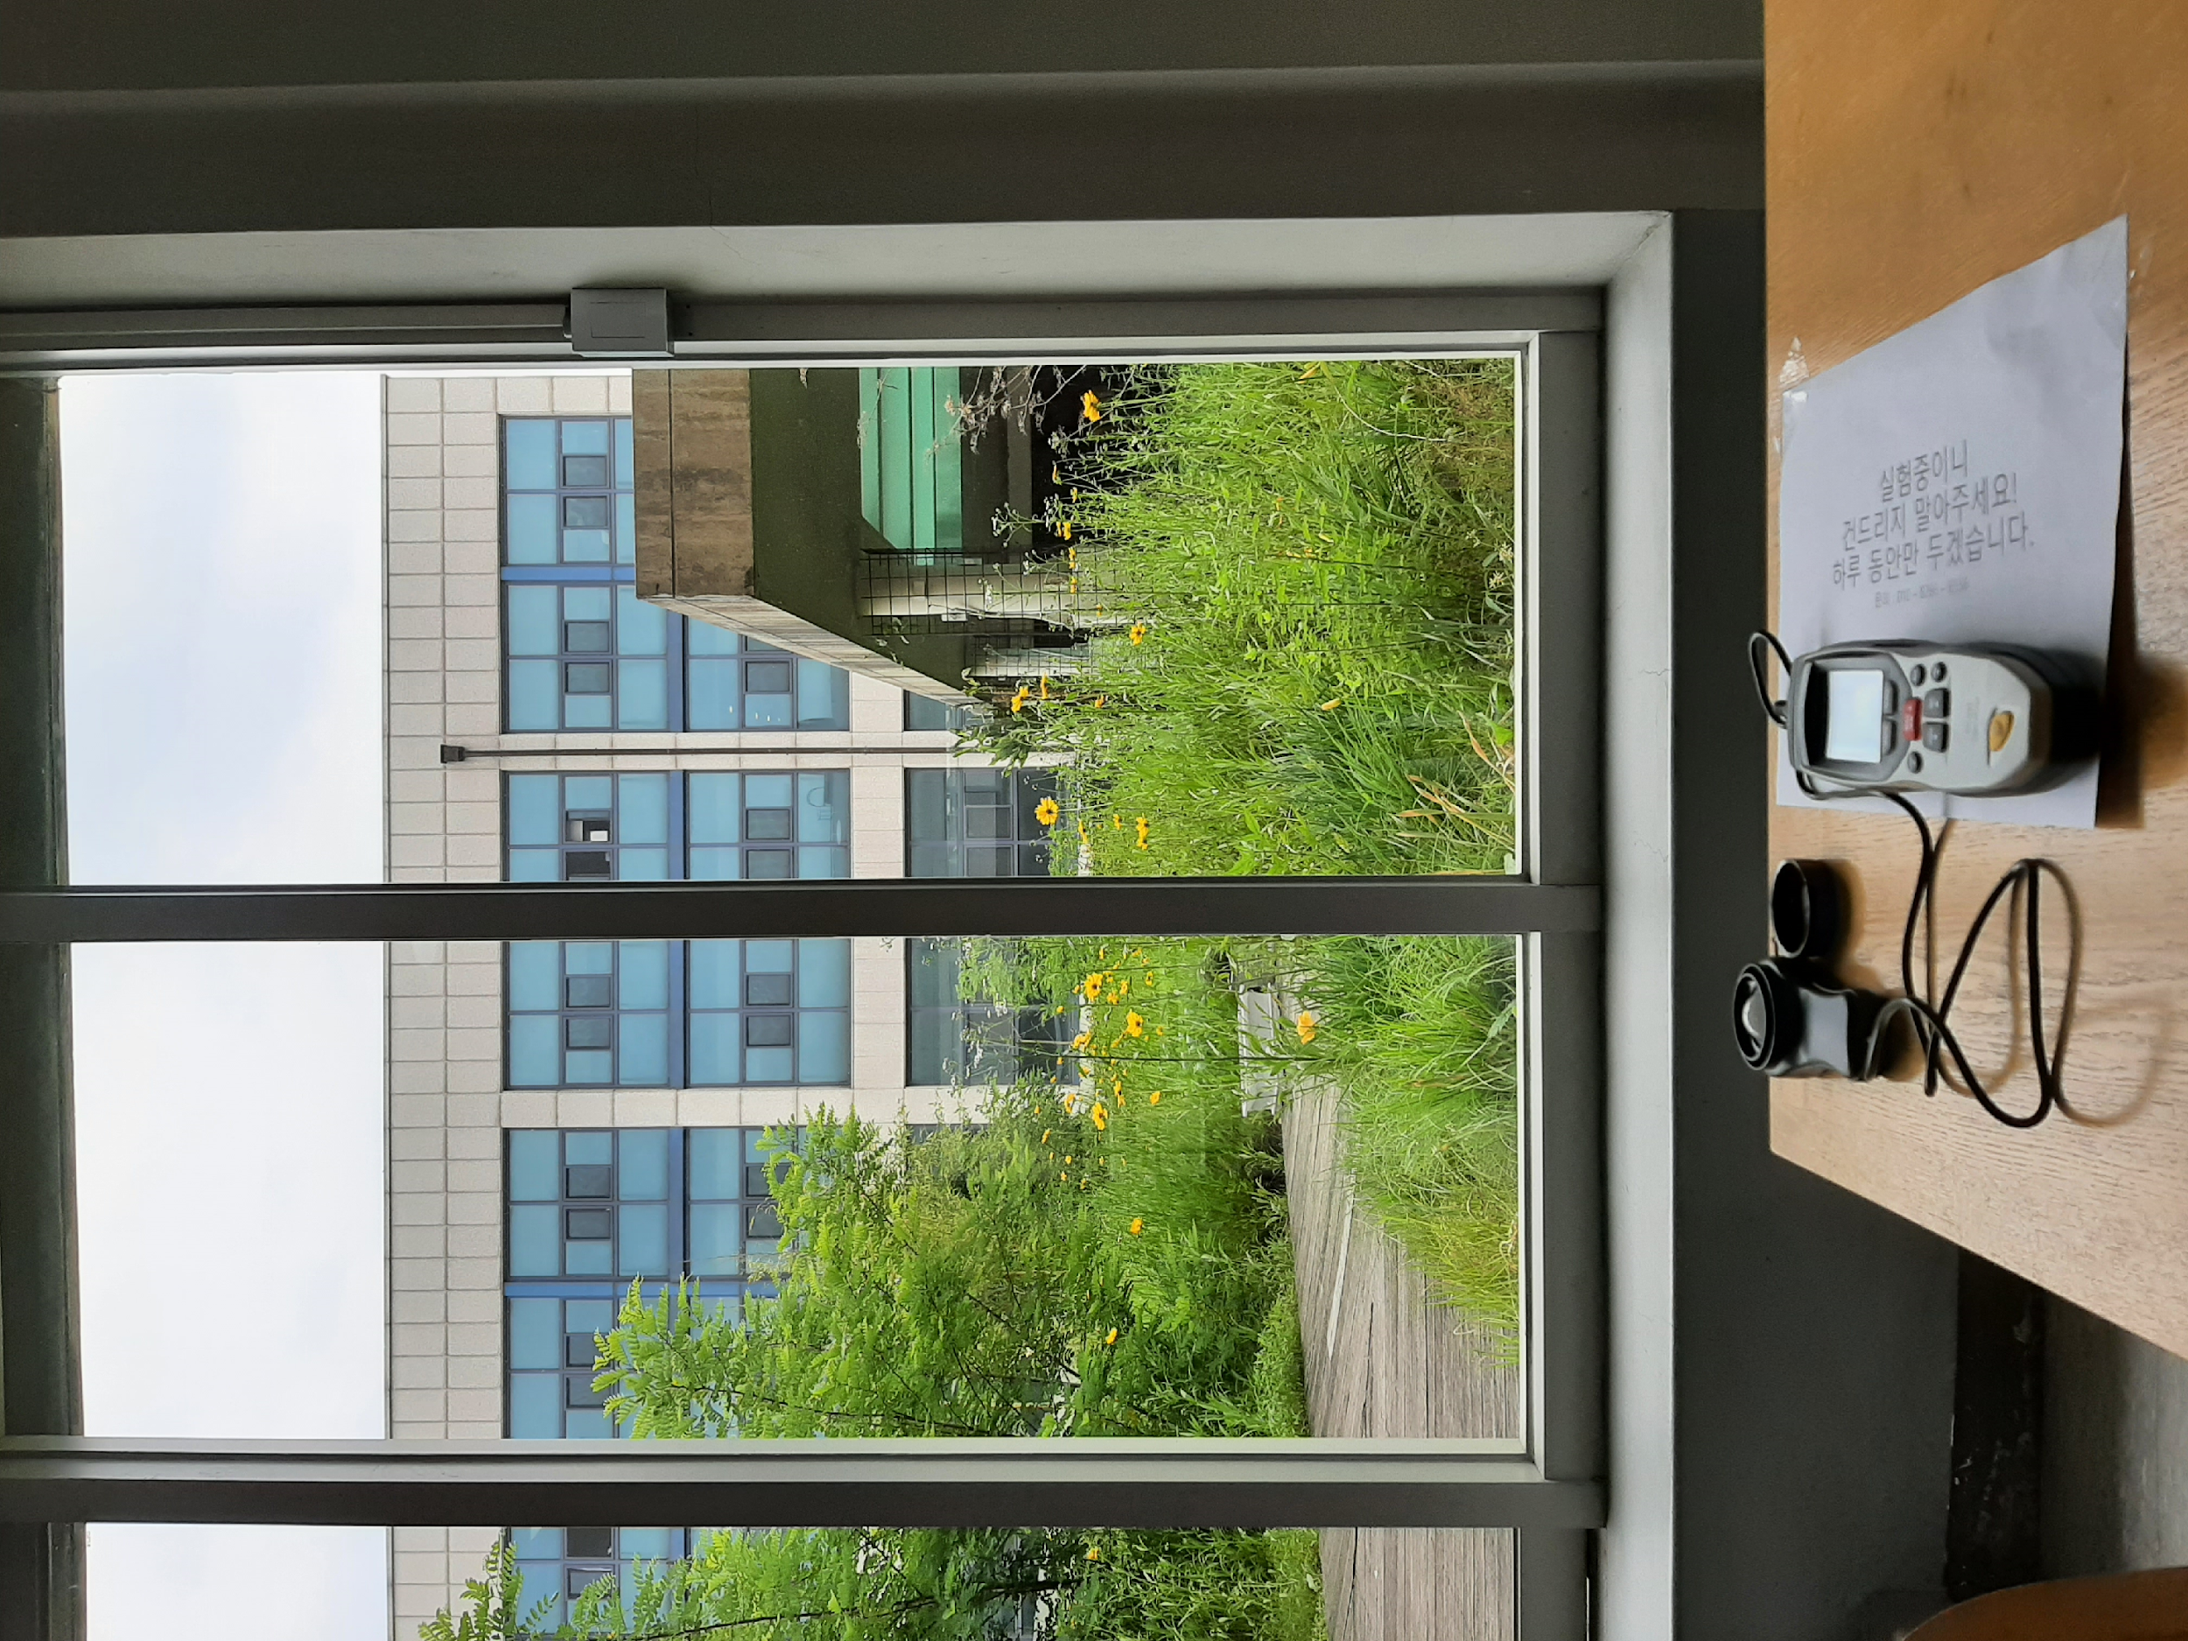
Data Collection
Methodology
1. Intensity of Illuminance
To control the experimental environment, we determined to collect data in the campus area
Thanks to the kind cooperation with administrative office and relative personnel from each buildings and laboratories, we could collect the data from 3 rooms in our campus.
Set up the devices to measure the natural light at indoor room
Measure the natural light in the 2nd and 6th floor, BLD 220
BLD 82
BLD 220
BLD 942
Seoul National University
Graduate School of Data Science

Slide 15
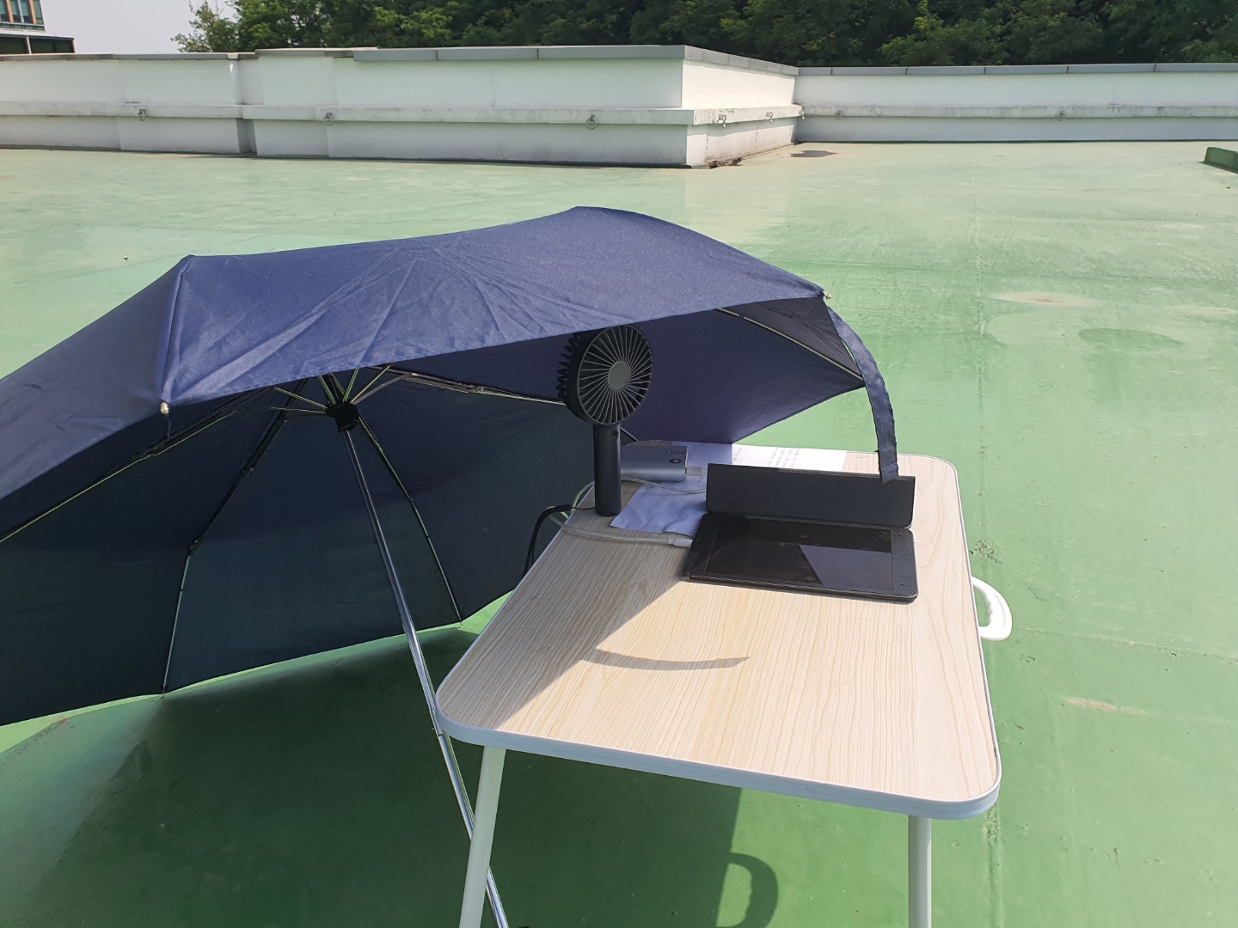
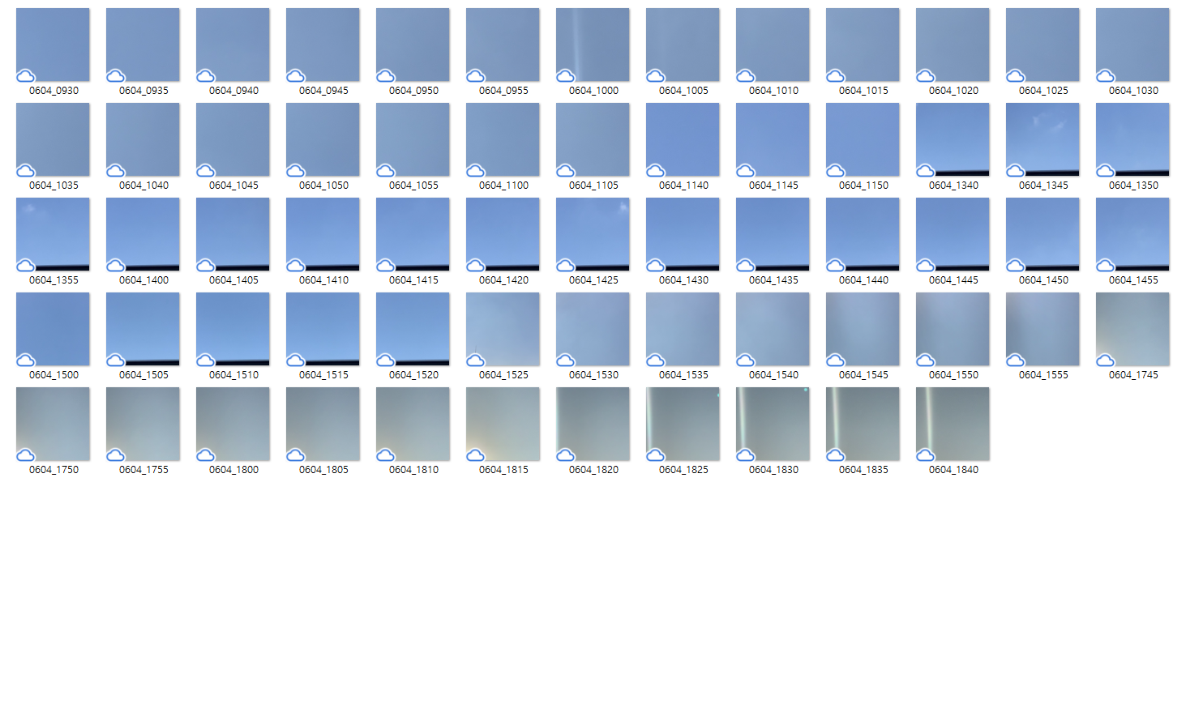
Data Collection
Methodology
2. Cloud Cover
Cloud cover affects incoming solar radiation.
Cloud cover varies even in small regions in a short period of time, we need a site-specific cloud cover in a and short-interval of time rather than meteorological data from AWS (Automatic Weather Station).
From the picture of the sky, we estimated the blueness of the sky during the preprocessing process
Taking video of sky on the roof
Pictures of sky every 5 minutes
Seoul National University
Graduate School of Data Science

Slide 16
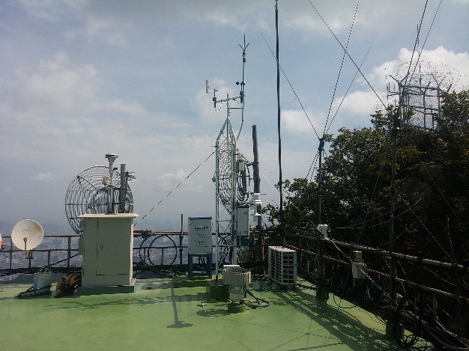
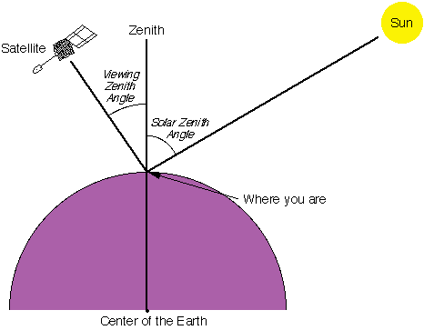

Data Collection
Methodology
3. Meteorological Data
Sunlight is heavily influenced by the weather condition of the site, and the amount clouds are determined by humidity and temperature.
We used the hourly temperature, precipitation and humidity data from Gwanak AWS(Automatic Weather Station) which is provided by KMA(Korea Meteorological Administration).
4. Characteristics of Site
The angle of incidence of the sunlight and the duration of daylight is determined by the location and elevation of the site. Shade from the surrounding buildings should also be considered.
We calculated Solar Zenith Angle with local time and latitude, which is proportional to the insolation.
Even in the same site, the intensity of daylight depends on the distance from the window and the direction and size of the window
Automatic Weather Station
Solar Zenith Angle
Characteristics of Window
Seoul National University
Graduate School of Data Science

Slide 17
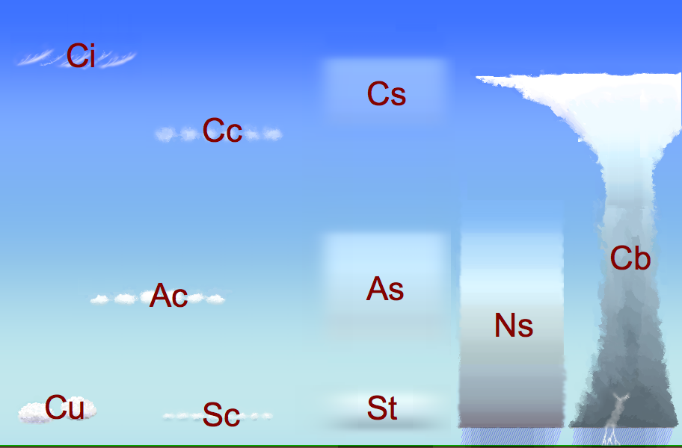

Preprocessing
Methodology
1. Estimation of the Cloudiness of the Sky
suggested in the Proposal : ceiling, amounts of clouds(finally we chose) e.g., when the clouds covered the sky … - getting darker in spite of the Sunlight
Problems :
1. The nearest AWS doesn’t offer both : (only in the ‘human station’)
2. And that is not a exact status on the ‘interested location’
3. couldn’t know the reference points for ceiling heights
“How we sense the sky covered by which cloud?”
amount ; When there’s no cloud (CLR), small amounts of clouds (SCT), middle amounts of clouds (BKN), overcasted (OVC) → Meteorological classification
sort ; more than 10 kinds of clouds but some are not affecting the sunlight
Fig. Cloud Classification by altitude of occurance
(from - https://commons.wikimedia.org/wiki/File:Wolkenstockwerke.png#/media/파일:Wolkenstockwerke.png)
Fig. Clouds getting cover the sunlights
(photo by Seongyong Park)
Seoul National University
Graduate School of Data Science

Slide 18
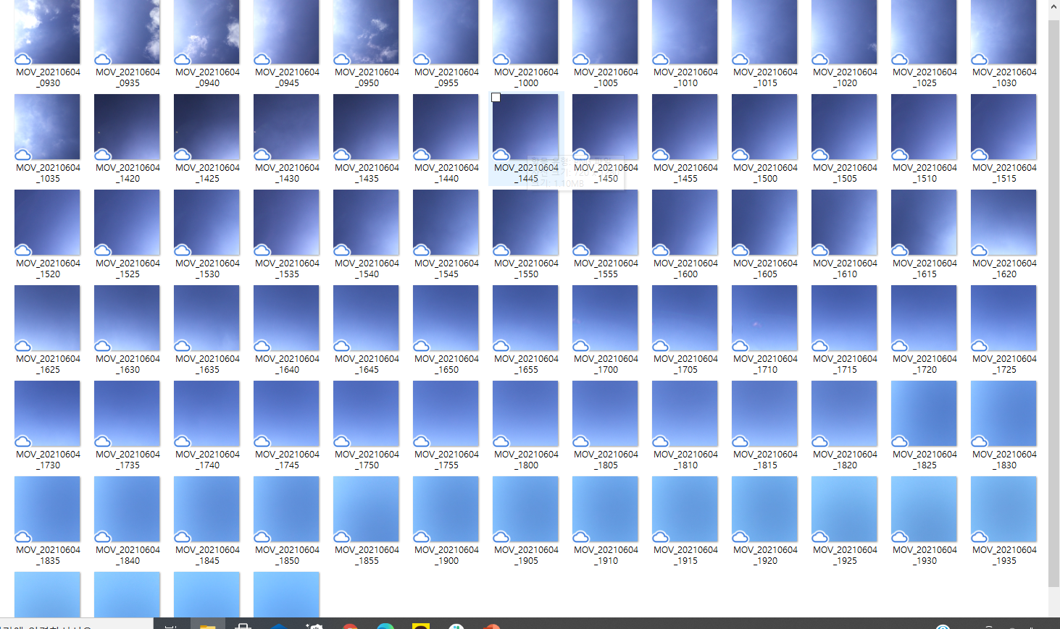
Preprocessing
Methodology
1. Estimation of the Cloudiness of the Sky (cont.)
“Cloud Sensing” has NOT been fully automated at most
however, still the status of the sky might be “sensitive” factor to the sunlight gathering in the building
Most of cloud related data (esp. ceiling, amounts) has been generated by the observation of human!!
Based on their experience and expertise, they refer to this heuristic rules
height of low ceiling : reference point of landscape (like mountain, building, commercial flights, etc.) → much smaller importance than “amount and sort”
amounts of clouds : proportion of the clouds (the white, grey, dark grey) in the view of sight → (our main concern; visually related to the indoor lighting)
sort of clouds : classification chart → not easy - even if the experts
To get the status of the sky to feed the ‘prediction model for indoor lighting’ : Starting from …… the colors we may see through the windows.
how much blue skies in your view of sight?
Deal with Cloud-like determination
(Calibrate & calculate the Bluesy)
Seoul National University
Graduate School of Data Science

Slide 19
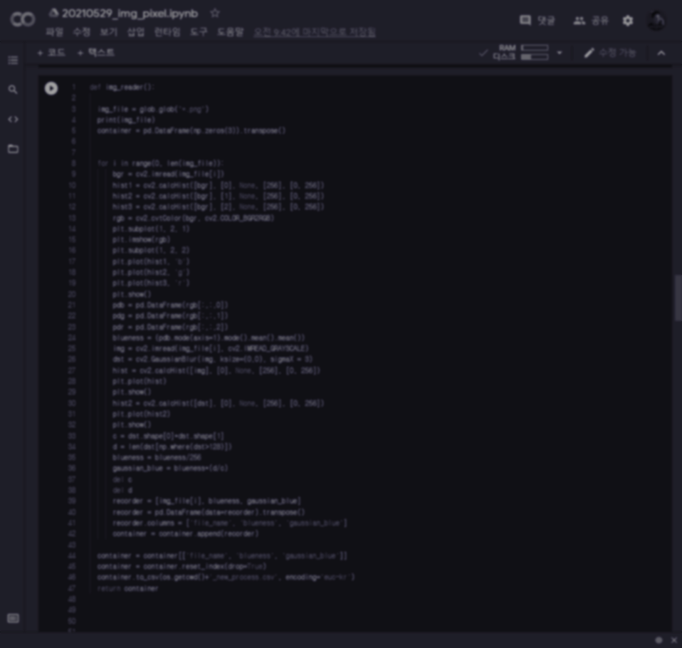
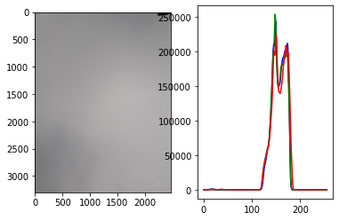
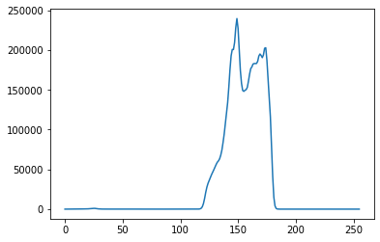
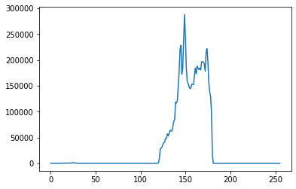
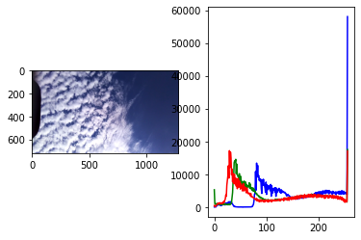
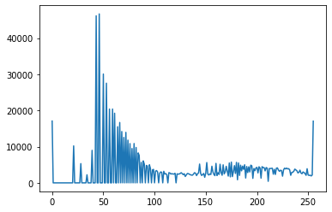
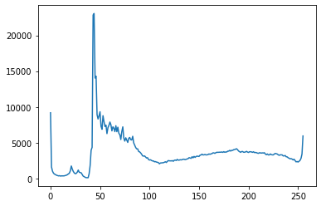
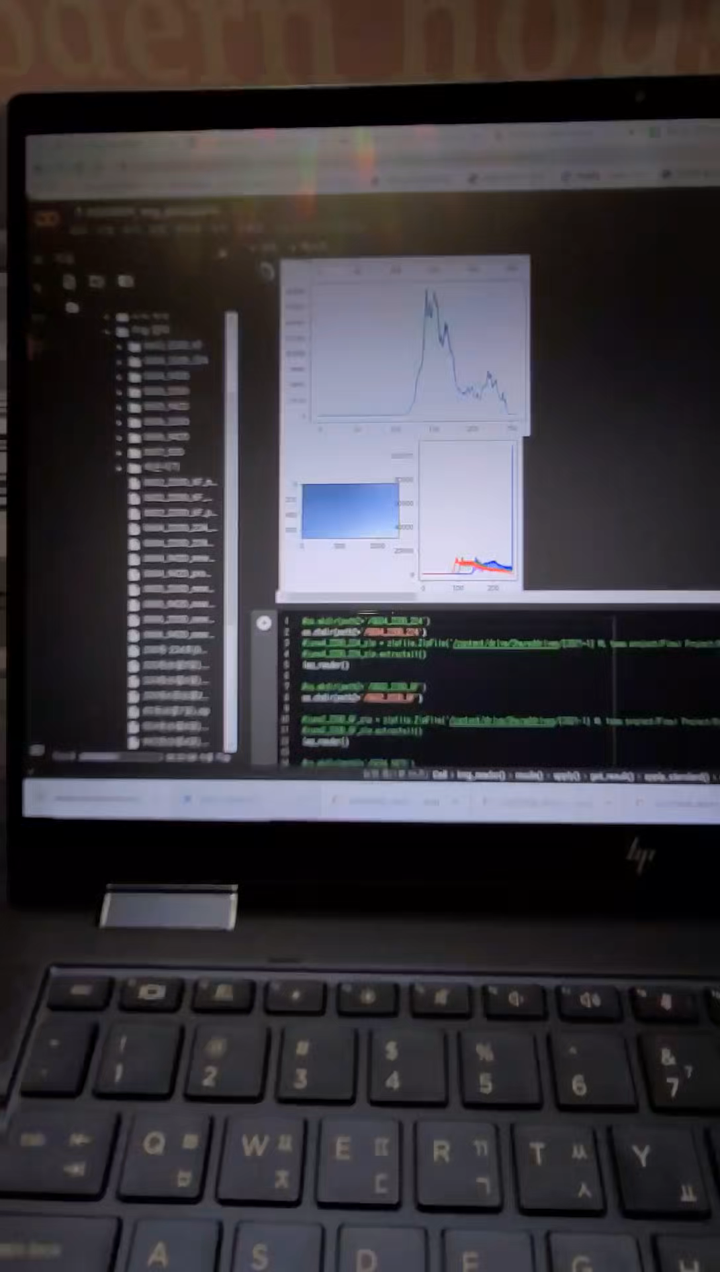
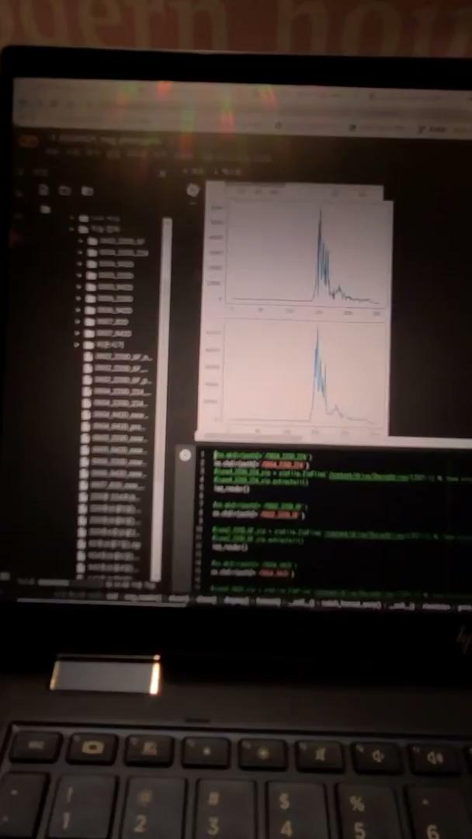
Preprocessing
Methodology
1. Estimation of the Cloudiness of the Sky (cont.)
Using python, opencv pkg
Video Image Processing + Rule based calculation
⇒ Generating data : ‘the status of sky on the top of my head’ in 5 min-term at each measuring location
RGB filters
how much blue skies in your view of sight?
Grey Scales
Deal with Cloud-like determination
Gaussian Filter
Calibrate noise-elimination
plus Scaling
Seoul National University
Graduate School of Data Science

Slide 20
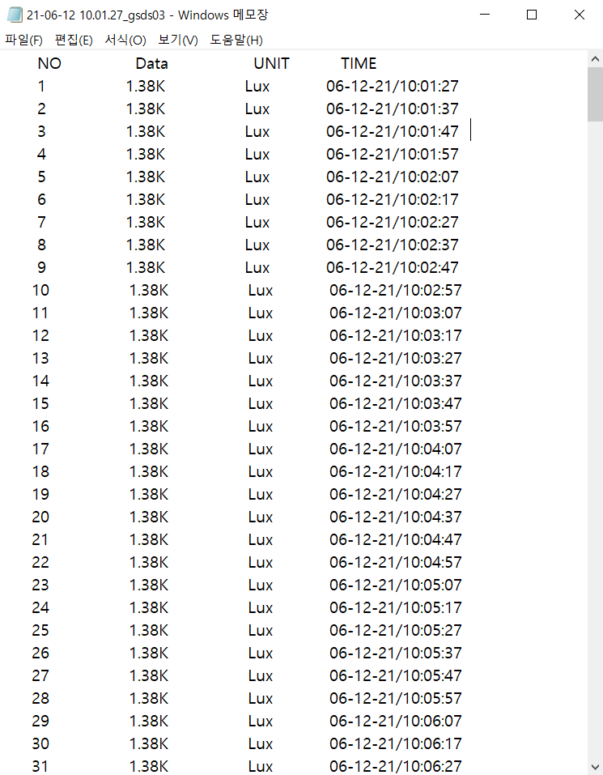
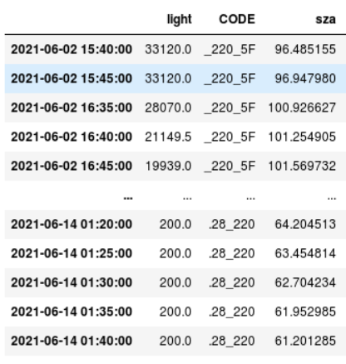
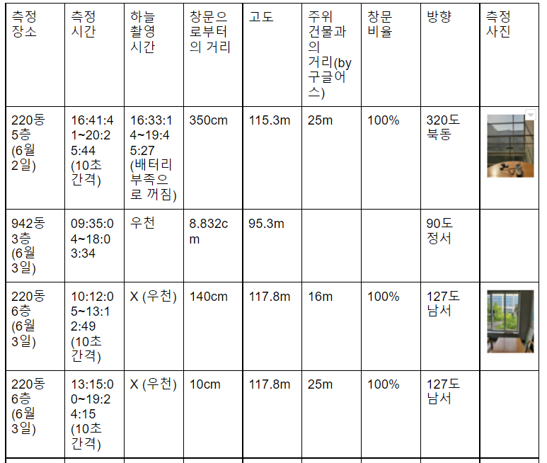
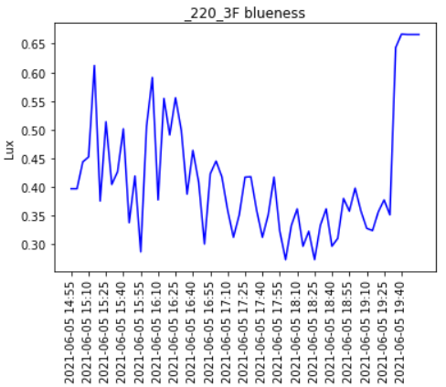
Preprocessing
Methodology
2. Preprocessed 5-minute interval dataset
Average 10-second interval illumination data for every 5 minutes
Organize all collected data(illuminance, meteorological data, site characteristic and cloudiness)
Remove or interpolate the missing data
Total 1251 measured data during 21/06/02 – 21/06/13
+
+
Measuring site information: Altitude, Distance from the window, Distance from the surrounding buildings, Direction of the window, Window to wall ratio,
Cloudiness calculated from the sky pictures in the previous preprocessing step
Average for 5-minute data
Calculate solar zenith angle with time, longitude, latitude
10-second interval illumination data
Organized all collected data & interpolated the missing data
Seoul National University
Graduate School of Data Science

Slide 21
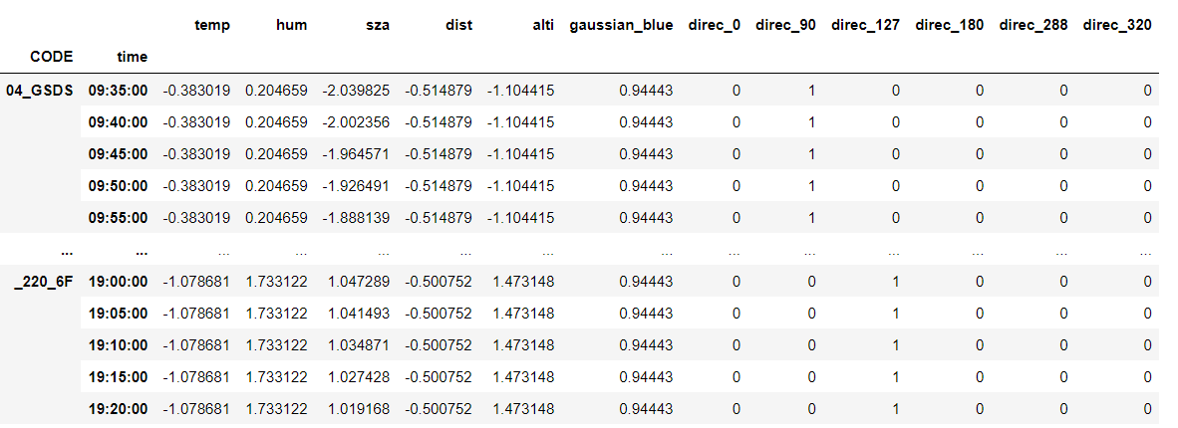
Preprocessing
Methodology
2. Preprocessed 5-minute interval dataset (cont.)
Log scaling for normalization
One hot encoding for direction
Grouping by ‘time’
Dataset Preparation
3. Prepared Dataset description
Temp: Temperature measured in Gwanak Mountain AWS
Hum: Humidity measured in Gwanak Mountatin AWS
Sza: South Zenith Angle
Dist: Distance between sensor & Windows
Alti: Altitude of Observatory
Gaussian_blue: Cloudeness over observatory with Gaussian filter
Direc: Directon of window & the room(We controlled other windows in our experimental environment)
Seoul National University
Graduate School of Data Science

Slide 22
Methodology
Technical Approach
Regression: Xgboost
Measurement of cloud: OpenCV
Train set: June 2nd to 6th
Test set: June 7th to 13th
Trial & Error
Among the candidate models, the XgBoost is very famous for its performance among the ensemble techniques using many of decision trees model
While we tried models like multivariate Linear Regression, decision tree, random forest, adaboost, and xgboost, the xgboost outperforms among those models.
Technical Challenges
How to exclude the effect of indoor lighting devices such as bulbs, displays, etc.
- Administrative cooperation
Features not sensitive(work) during the period Features hard to make it numeric (quantitative)
- Adding variable for measuring cloud
Controlling experimental environment
Ex. Overheating of observation machine, malfunction of sensors, controlling luminance source, weather
Expected Problem examples - solved
Not expected problem
Seoul National University
Graduate School of Data Science

Slide 23
Results

Slide 24
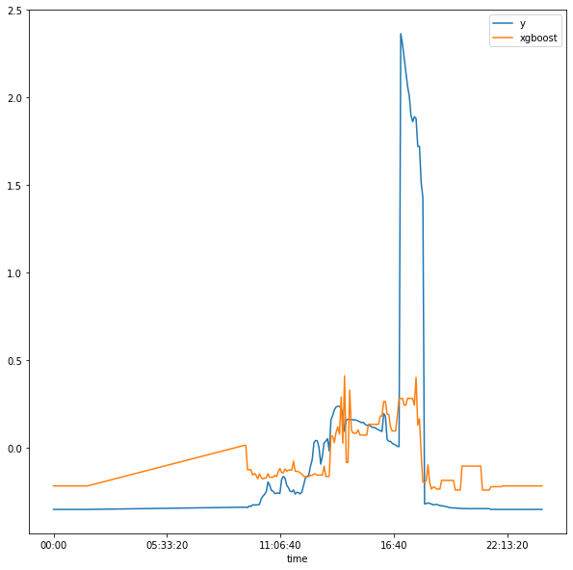
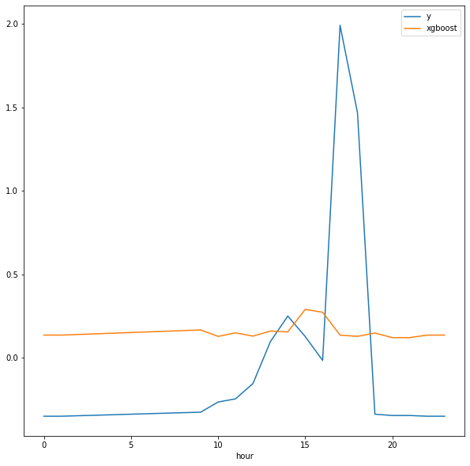
Results(Extended 10 days)
Results
Frequency: 5 minutes
Frequency: an hour
X axis: time // Y axis: log(Lux)
Yellow line: predicted Lux. from June 7th to 13th
Blue line: actual Lux. from June 7th to 13th
(Extend 10 days after presentation)
Seoul National University
Graduate School of Data Science

Slide 25
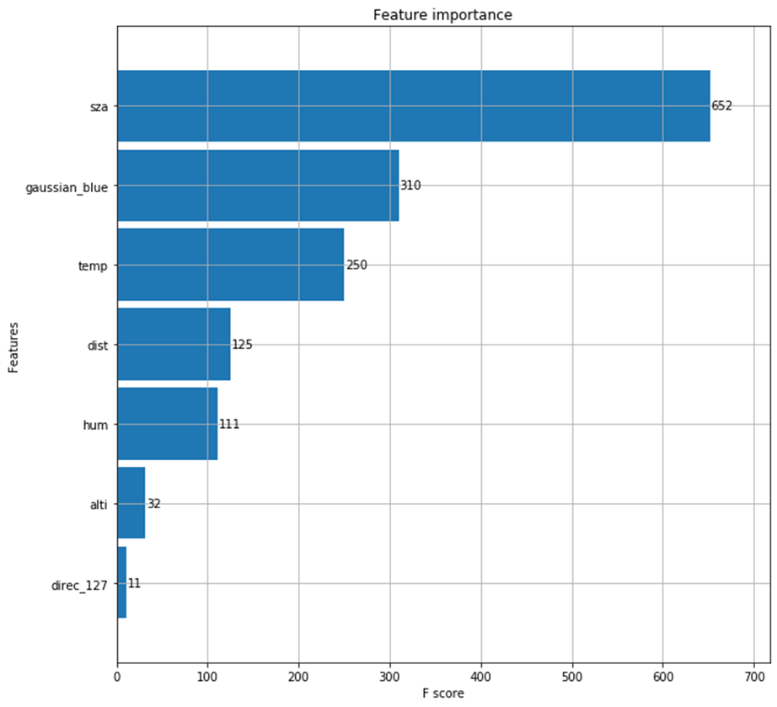
Results
Results(Extended 10 days) & Limits
Let’s back to move on to the first question we suggested.
“Is this room face the south?”
The result said that…
“No, it does NOT matter with the direction of window.”
Meteorological variables have much more importance to the result.
The direction of window does NOT determine the total amount of window, but the total amount of time (or duration) when the “high luminance” in that room!
Of course, we have limitation there is some reason that our observing period is limited to early June, so we ignored seasonality.
Seoul National University
Graduate School of Data Science

Slide 26
Results
Results(Extended 10 days) & Limits
The Answer to the first question when finding a room
The strength of direct solar light sources is greatly affected by sky conditions(clouds) or the weather conditions, (explained in our model by gaussian_blue, temparture, humidity, etc.)
but the continuous supply of light of moderate intensity has more impact on the characteristics of the place. (explained in our model by SZA & directions of window)
Seoul National University
Graduate School of Data Science

Slide 27
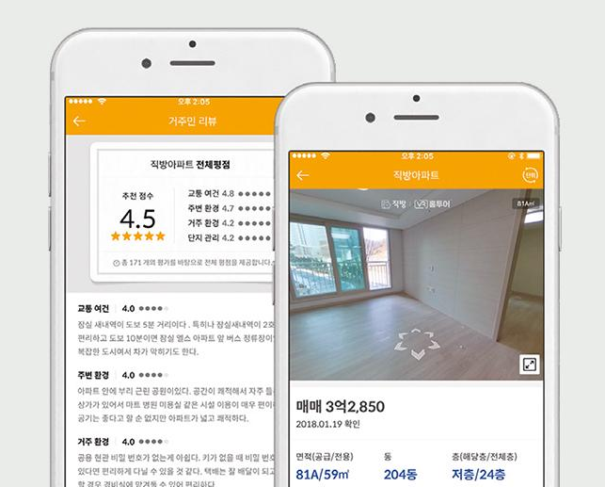
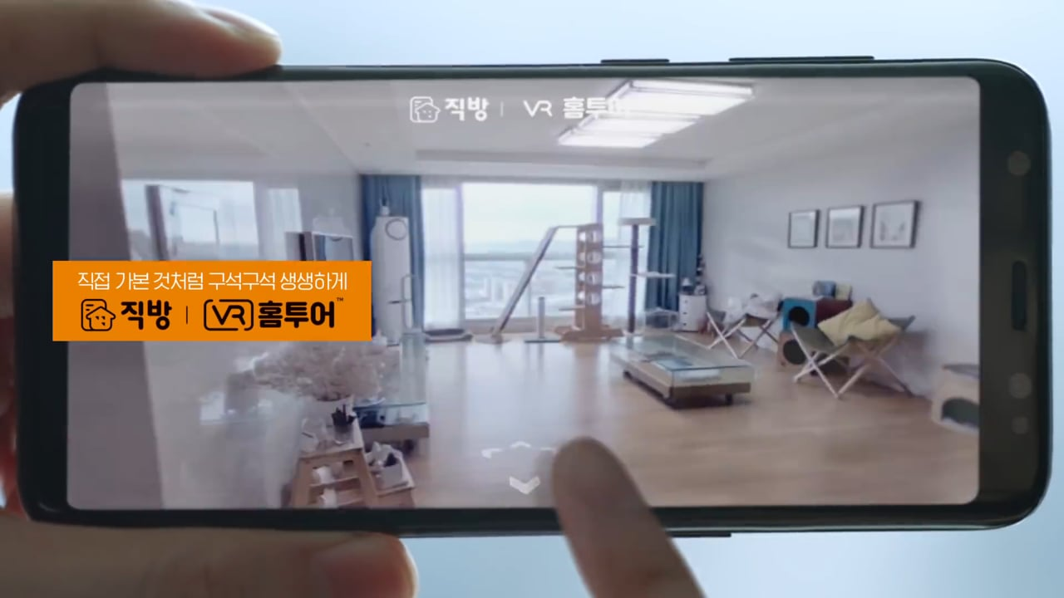
Novelty / Merits
Results
Novelty
We generated a new variable(cloudiness) which is not previously used.
We can automatically estimate the indoor light, which can help people to find the room with good light.
2. Merits
It could be used everywhere!
Especially useful for the real estate applications
Developing application for providing the indoor light information
It can tell you exactly how much light will come in.
Seoul National University
Graduate School of Data Science

Slide 28
Future Plan

Slide 29
Limitation
Future Plan
Lack of the number of data (short time of measurement)
We carried out the experience around 10 days
We couldn’t measure the light especially in the morning (08~12 AM)
Measurement biased in only one season, early summer
It is hard to reflect the seasonality of the weather, since we measured only in early summer
Problems with the instrument
Cell phone turned off when it gets sunlight and heat for a long time – missing value in sky photos
Illuminometer didn’t work sometimes – strange values or outliers exists in the data
Other variables that we didn’t consider
Distance between buildings, window size and so on…
Future Work
Collecting more measurement
For each site, it is necessary to measure the illuminance at least 3 days
To reflect the seasonality of weather condition, long-term measurements are needed
Applying different algorithm such as RNN & LSTM to the model
To get higher accuracy, applying various algorithm to the model
Evaluation of the model
Applying developed model to other sites
Seoul National University
Graduate School of Data Science

Slide 30
Thank you!

